Slide 1
PSY102: Introduction to Cognitive Psychology
Day 17 (06/07/19): Motivated reasoning

Slide 2
Today’s Goals + Agenda
LO1: Continue to build a supportive classroom culture & discuss science communication.
How does the media cover research on motivated reasoning et al.?
What do these papers mean in terms of how we would communicate controversial science? We will reconsider this in sum on Monday.
LO2: Define, identify, and apply previous constructs that we have discussed in class
Quiz on material covered since the last quiz: multiple choice & short answer
LO3: Describe the basic fundamental principles underlying human judgment & connect to our critical analysis of journal articles.
Describe basic research on motivated reasoning, inductive reasoning, representativeness heuristic, availability heuristic, conjunction rule, confirmation bias, law of large numbers, peak-end effect & loss aversion, etc.,
How does this research impact our approach to the scientific method & open science?
What does this research suggest about how we can change people's minds?

Slide 3
Monday’s Work
Read Levari et al. (2018) (prevalence-induced concept change)
Optional reading: Klein & O’Brien (2018) (amnt of information we use in making decisions)
Comic: Believe! (on backfire effect)
Podcast: Active Information Avoidance
Outline on Duke Research Blog
Theme: What are some other cognitive biases that affect our reasoning and decision-making, and how does this impact science communication?

Slide 4
Today’s themes
How do people make judgements?
Can you change people’s minds?

Slide 5
Judgment & Decision-Making
Inductive reasoning: drawing a conclusion based on evidence from observations
Conclusions are “probably true” (not definitely)
Often uses memory
Notes:
Inductive reasoning
•Reasoning that is based on observation
•Reaching conclusions from evidence
•Strength of argument
–Representativeness of observations
–Number of observations
–Quality of observations
•Used to make scientific discoveries
–Hypotheses and general conclusions
•Used in everyday life
–Make a prediction about what will happen based on observation about what has happened in the past

Slide 6
Inductive Reasoning
Observation: All the crows I’ve seen in Pittsburgh are totally black. When I visited my brother in Washington, DC, the crows I saw there were black too.
Conclusion: I think it is a pretty good bet that all crows are black.

Slide 7
What makes for a good inductive argument?
Representativeness of observations
(e.g., WEIRD samples - not great)
Number of observations
(e.g., sample size)
Quality of the evidence
Predictions on what will happen based on what has happened in the past.

Slide 8
Heuristics
“Rules of thumb” that are likely to provide the correct answer to a problem, but are not foolproof
Heuristics: not always terrible! (But sometimes terrible)

Slide 9
____________ Heuristic
“Which are more prevalent in English, words that begin with the letter R or words in which R is the third letter?”

Slide 10
____________ Heuristic
Some possible causes of death are listed below in pairs. Within each pair, which cause of death do you consider to be more likely for people in the United States? That is, if you randomly picked someone in the United States, would that person be more likely to die next year from cause A or cause B?
Cause A:
Homicide
Auto-train collision
Botulism
Asthma
Appendicitis
Cause B:
Appendicitis
Drowning
Asthma
Tornado
Pregnancy

Slide 11
Availability Heuristic
“Which are more prevalent in English, words that begin with the letter R or words in which R is the third letter?”
Easier to bring words that begin with R to mind
Conclusion: more words begin with R
In reality, >3x more words have R in the third position

Slide 12
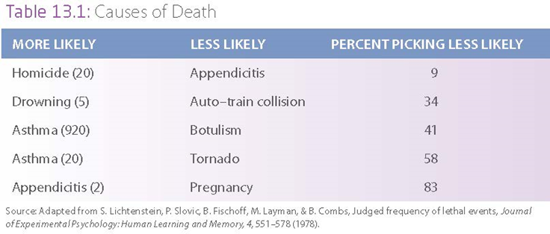
Availability Heuristic
Notes:
20 x more people die of homicide than appendicitis…. Compared to 9 percent of subjects thought it was more likely people would die from appendicitis than homicide
5 x more people die of drowning than collisions
920 x more people die of asthma than botulism
20 x more people die of asthma than tornado
2 x more people die of asthma than pregnancy
When people die of botulism or in a tornado, it’s front-page news; people dying of asthma, relatively unnoticed in our public cycle

Slide 13
Availability Heuristic
Information (or events) that is more easily remembered is judged as being more probable than events information (or events) are less easily remembered
Social media pictures
easily available, easily remembered
Conclusion: my friends are doing fun, fulfilling things more frequently than they really are

Slide 14
Availability Heuristic
Illusory correlation: association between variables “seemingly” exists, but doesn’t or is pretty weak
Pop culture in media makes things more available
Stereotypes
Oversimplified generalizations about a group or class of people
Often focuses on the negative
If mediated by pop culture at all, the availability heuristic can create a stereotype that does not map onto reality (“all members of this group are ___”)
Notes:
•Illusory correlations: correlation appears to exist, but either does not exist or is much weaker than assumed
–Stereotypes: Oversimplified generalizations about a group or class of people that often focuses on the negative
-o stereotype: pay more attn to particular stereotyped behavior, then creates an illusory correlation to reinforce the stereotype… selective attn to the behaviors makes them more “available”

Slide 15
Random Dude from N.C.
Jack is a 45-year-old man. He is married and has four children. He is generally conservative, careful, and ambitious. He shows no interest in political and social issues and spends most of his free time on his many hobbies, which include home carpentry, sailing, and mathematical puzzles.
What’s the likelihood that Jack is a lawyer or engineer?
Notes:
Image credit: theidleman.com
→ Availability heuristic related to how often we expect events to occur; representativeness heuristic related to making judgments based on how much one event resembles another
→ this information causes people to think Jack is an engineer, not lawyer

Slide 16
Representativeness Heuristic
In a group of 100 people, there are 70 lawyers and 30 engineers. What’s the chance that if you pick one person from the group at random that the person will be an engineer?
Jack is in this group. Would you change your estimate?
Notes:
→ Availability heuristic related to how often we expect events to occur; representativeness heuristic related to making judgments based on how much one event resembles another
•Representativeness heuristic: the probability that A is a member of class B can be determined by how well the properties of A resembles properties normally associated with class B
–Use base rate information if it is all that is available
–Use descriptive information if available and disregard base rate information

Slide 17
Representativeness Heuristic
Heuristic: “Probability that A is a member of class B can be determined by how well the properties of A resemble the properties we usually associate with class B”
Base rate: Relative proportion of different classes in the population (70:100 for lawyers; 30:100 engineers)
When descriptive information is available, people don’t think about the base rate to make their estimates.
Not always bad; descriptive information is still useful.
Notes:
→ Availability heuristic related to how often we expect events to occur; representativeness heuristic related to making judgments based on how much one event resembles another
•Representativeness heuristic: the probability that A is a member of class B can be determined by how well the properties of A resembles properties normally associated with class B
–Use base rate information if it is all that is available
–Use descriptive information if available and disregard base rate information

Slide 18
Linda is 31 years old, single, outspoken, and very bright. She majored in philosophy. As a student, she was deeply concerned with issues of discrimination and social justice, and also participated in antinuclear demonstrations. Which of the following alternatives is more probable?
1. Linda is a bank teller.
2. Linda is a bank teller and is active in the feminist movement.
Notes:
•Conjunction rule: probability of two events cannot be higher than the probability of the single constituents

Slide 19
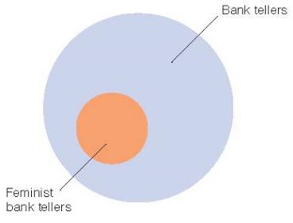
Conjunction Rule
Probability of 2 events cannot be higher than the probability of each single event, yet most people pick #2
Linda is 31 years old, single, outspoken, and very bright. She majored in philosophy. As a student, she was deeply concerned with issues of discrimination and social justice, and also participated in antinuclear demonstrations. Which of the following alternatives is more probable?
1. Linda is a bank teller.
2. Linda is a bank teller and is active in the feminist movement.
Notes:
•Conjunction rule: probability of two events cannot be higher than the probability of the single constituents
→ 85 % people of people picked statement 2
→ making judgements without considering the conjunction rule!!

Slide 20
Male & Female Births
A certain town is served by two hospitals. In the larger hospital about 45 babies are born each day, and in the smaller hospital about 15 babies are born each day. As you know, about 50 percent of all babies are boys. However, the exact percentage varies from day to day. Sometimes it may be higher than 50 percent, sometimes lower. For a period of 1 year, each hospital recorded the days on which more than 60 percent of the babies born were boys. Which hospital do you think recorded more such days?
The larger hospital?
The smaller hospital?
About the same

Slide 21
Errors happen when you assume a small number of folks accurately represent the population
Law of large numbers: the larger the number of individuals randomly drawn from a population, the more representative the resulting group will be of the entire population
Samples of small numbers of individuals will be less representative.
So, in the large hospital, should be closer to 50%, but much farther away from 50% in the small hospital (i.e., right answer is small hospital)

Slide 22
How to Not Do Science
Confirmation bias: tendency to selectively look for information that conforms to our hypothesis and overlook information that argues against it (like a pair of “blinders”)
Myside bias: tendency for people to generate and evaluate evidence and test their hypotheses in a way that is biased toward their own opinions and attitudes
Confirmation bias is any situation where you are unknowingly trying to confirm; myside bias is a subset of that
Notes:
•The myside bias: tendency for people to generate and evaluate evidence and test their hypotheses in a way that is biased toward their own opinions and attitudes
•The confirmation bias: tendency to selectively look for information that conforms to our hypothesis and overlook information that argues against it
•

Slide 23
Myside Bias
Lord and coworkers (1979)
Had those in favor of capital punishment and those against it read the same article
Those in favor found the article convincing
Those against found the article unconvincing

Slide 24
Pennycook’s preprint: A case study in correcting confirmation bias
“Actively open-minded thinking about evidence" (AOT-E) - that is, self-reporting that you think beliefs and opinions *should* change according to evidence - is a really strong correlate of lots of things.”
But what would the paper have been if there hadn’t been healthy skepticism on the part of the researcher?
Notes:
https://twitter.com/GordPennycook/status/1132020280132603904
Skipped these slides, since the podcast discusses confirmation bias!

Slide 25
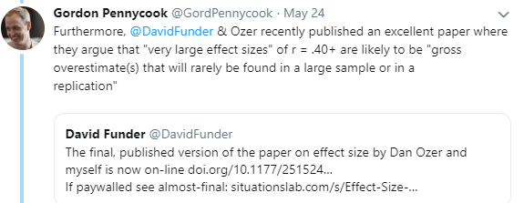
Correct for Confirmation Bias
Notes:
https://twitter.com/GordPennycook/status/1132020280132603904
Skipped these slides, since the podcast discusses confirmation bias!

Slide 26
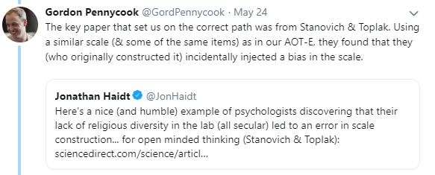
Correct for Confirmation Bias
Notes:
https://twitter.com/GordPennycook/status/1132020280132603904
Skipped these slides, since the podcast discusses confirmation bias!

Slide 27
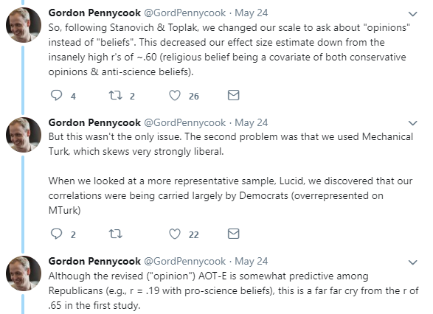
Correct for Confirmation Bias
Notes:
https://twitter.com/GordPennycook/status/1132020280132603904
Skipped these slides, since the podcast discusses confirmation bias!

Slide 28
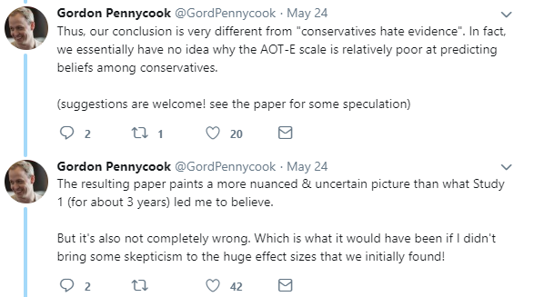
Correct for Confirmation Bias
And Open Science Helps
Notes:
https://twitter.com/GordPennycook/status/1132020280132603904
Skipped these slides, since the podcast discusses confirmation bias!

Slide 29
Anchoring Heuristic
When faced with an estimation task…
Use prior knowledge as an anchor (even if you just got it) - i.e., a reference point
Adjust away
(It’s usually an insufficient adjustment, so initial anchor makes a BIG difference)
Notes:
https://www.youtube.com/watch?v=NFiDdbquWJY&index=2&list=PL0q1l3zKRdt4oJHJxEtGWqsiad1exWCcJ
https://www.youtube.com/watch?v=RhyJGwNpEcw&list=PL0q1l3zKRdt4oJHJxEtGWqsiad1exWCcJ&index=6
https://www.youtube.com/watch?v=LBNtChg4t4k&list=PL0q1l3zKRdt4oJHJxEtGWqsiad1exWCcJ&index=4

Slide 30
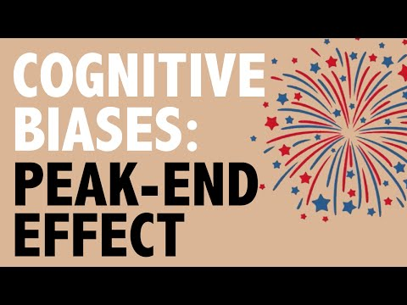
Peak-End Effect
Notes:
https://www.youtube.com/watch?v=NFiDdbquWJY&index=2&list=PL0q1l3zKRdt4oJHJxEtGWqsiad1exWCcJ
https://www.youtube.com/watch?v=RhyJGwNpEcw&list=PL0q1l3zKRdt4oJHJxEtGWqsiad1exWCcJ&index=6
https://www.youtube.com/watch?v=LBNtChg4t4k&list=PL0q1l3zKRdt4oJHJxEtGWqsiad1exWCcJ&index=4

Slide 31
Peak-End Effect
You judge an experience based largely on how you feel at its peak and its end rather than a sum or average of every moment
Notes:
https://www.youtube.com/watch?v=NFiDdbquWJY&index=2&list=PL0q1l3zKRdt4oJHJxEtGWqsiad1exWCcJ
https://www.youtube.com/watch?v=RhyJGwNpEcw&list=PL0q1l3zKRdt4oJHJxEtGWqsiad1exWCcJ&index=6
https://www.youtube.com/watch?v=LBNtChg4t4k&list=PL0q1l3zKRdt4oJHJxEtGWqsiad1exWCcJ&index=4

Slide 32
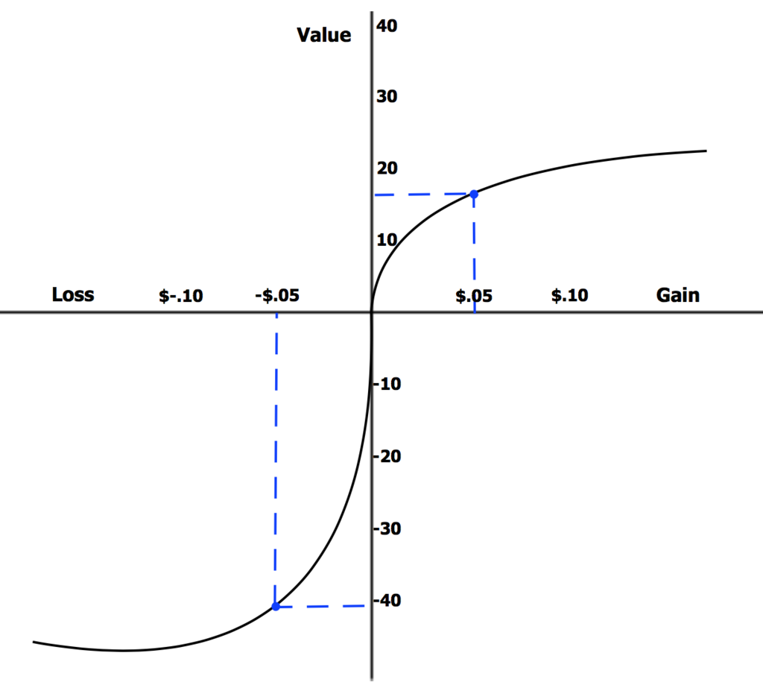
Loss Aversion
Tendency to avoid losses rather than acquire gains
Remember our scenario on Program A/B/C/D and the certainty of people dying? →
So many other heuristics… see: GI-Joe Fallacy, Pricing Biases, Mental Accounting, Alief, etc.

Slide 33
Our judgments about risk are also weird
If Program A is adopted, 200 people will be saved.
If Program B is adopted, there is a 1/3 probability that 600 people will be saved, and a 2/3 probability that no one will be saved.
72% wanted to go with Program A (definite strategy (risk aversion)).
If Program C is adopted, 400 people will die.
If Program D is adopted, there is a 1/3 probability that nobody will die, and a 2/3 probability that 600 people will die.
78% wanted to go with Program D (risky strategy (risk-taking)).
Framing effect: decisions are influenced by how the choices are framed
When choices are framed in terms of gains, people tend to be risk-averse
When choices are framed in terms of losses, people tend to be risk-taking
Notes:
•Tversky and Kahnemann (1981)
• Saving 200 lives with certainty is more attractive than ⅔ probability of saving no one
• Certain death of 400 people less acceptable than 2 in 3 risk that 600 people will die
• programs are identical - 400 die, 200 saved in both Program A & C, and in B and D, ⅔ chance of none saved/600 die (+ ⅓ chance of 600 saved, none died)

Slide 34
Loss Aversion
Tendency to avoid losses rather than acquire gains
Tendency to choose Program A/D over Program B/C is not just about framing. It’s also that we have loss aversion.
So many other heuristics… see: GI-Joe Fallacy, Pricing Biases, Mental Accounting, Alief, etc.

Slide 35
Can we change people’s minds?

Slide 36
Day 1: More Information Isn’t Enough
(cc: Nyhan et al. (2014), Pediatrics)
Notes:
On day 1, I mentioned this in relation to thinking about SciComm. Relevant again here!
From: Nyhan, B., Reifler, J., Richey, S., & Freed, G. L. (2014). Effective messages in vaccine promotion: a randomized trial. Pediatrics, 133(4), e835-e842.
“Refuting claims of an MMR/autism link successfully reduced misperceptions that vaccines cause autism but nonetheless decreased intent to vaccinate among parents who had the least favorable vaccine attitudes….”
Via Wikipedia (https://en.wikipedia.org/wiki/Information_deficit_model), the information deficit model (or simply deficit model) or science literacy/knowledge deficit model attributes public scepticism or hostility to science and technology to a lack of understanding, resulting from a lack of information. It is associated with a division between experts who have the information and non-experts who do not. The model implies that communication should focus on improving the transfer of information from experts to non-experts.
· More information does not equal greater acceptance of science

Slide 37
Podcast: I’m Right, You’re Wrong
How does the media cover this topic, knowing that data is not enough?
How do you change minds?
What are some other factors that impact our decision-making, per the podcast?
Notes:
→ the fear about vaccines (contrasted to Trump’s speech); data is not enough!
→ is confirmation bias rational? Sure, sometimes heuristics are OK in the long-run, but are not so great in the moment. So, Shankar’s example of how ya, if you’ve seen gravity work your entire life, and then see a pig flying, you’re not going to suddenly stop believing in gravity.
→ change people’s behavior with fear? She mentions when people are stressed out (tapping into their mindset) and when you’re trying to get someone to not do something (inaction)
→ story of positive feedback in the hospital (to get the medical staff to wash hands before/after)
→ equality heuristic: we tend to assign equal weight to everyone’s opinion; tallying everyone’s opinion instead of the person who has the most expertise
→ the surprisingly popular vote: what’s the capital of Brazil? What do you think most people will say is the capital? If you have the wrong answer, you’ll think most people think that. But if you have expertise, you’ll have different answers to the questions.
→ STORY-TELLING (Uri Hasson story), synchronization of brains, synchronization was important for INFLUENCE (connecting back to our third day of class on shared attention!!), getting us to feel what the story-teller wanted us to feel

Slide 38
Podcast: I’m Right, You’re Wrong
“There's four factors that determine whether we're going to change our beliefs - our old belief, our confidence in that old belief, the new piece of data and our confidence in that piece of data. And the further away the piece of data is from what you already believe, the less likely it is to change your belief.”
Remember Perception (Day 3 + Review on Day 8)?
Remember Bayesian updating of priors?
Coupling of minds -- sound familiar (shared attention, Day 4)?
Everything from the 1st half of the course will be applied to everything in the 2nd half of the course...
Notes:
→ Tali Sharot was discussing what determines you changing your mind… and discussed Bayesian updating of priors in a really accessible way!

Slide 39
Can you change people’s political opinions with reasoning?
Stanley et al. (2019)
How did they test this?
If you had to give a one-sentence summary of figures & overall of the paper, what would you say?
What do you want to know more about & what were limitations
Take the next 5 min to discuss with the other folks in the class near you & refresh your memory of the article

Slide 40
Fracking is a process by which natural gas is extracted from reservoirs below the Earth’s surface. As part of the fracking processing, chemicals, sand, and water are injected into rock at high pressure, allowing gas from below to flow above the surface of the rock, where it is then collected. Fracking is a currently a contentious issue in the United States. Some people support fracking in the United States, and other people do not support fracking in the United States.
The United States economy used to operate on a gold standard, meaning that the value of currency was backed by gold reserves. In 1971, however, the United States abandoned the gold standard, handing the government full responsibility and control over the dollar. There is currently debate over whether the United States should return to the gold standard. There are several reasons one might support the United States returning to a gold standard, and there are several reasons one might oppose the United States returning to a gold standard.
Notes:
If curious about the materials
A: Issues and Reasons
Fracking in the United States
Fracking is a process by which natural gas is extracted from reservoirs below the Earth’s surface. As part of the fracking processing, chemicals, sand, and water are injected into rock at high pressure, allowing gas from below to flow above the surface of the rock, where it is then collected. Fracking is a currently a contentious issue in the United States. Some people support fracking in the United States, and other people do not support fracking in the United States.
Reasons to support the position that fracking for natural gas should be permitted in the United States:
Fracking helps the United States to achieve the goal of energy independence.
Fracking contributes to lower gas prices in the United States.
Fracking can boost state and local economies in the United States.
Fracking provides many well-paying jobs to geologists, well drillers, office workers, truck drivers, construction workers, and so on.
Natural gas is one of the cleanest sources of non-renewable energy.
Greater reliance on natural gas instead of coal and oil can help the United States reduce harmful carbon dioxide emissions.
Fracking projects generate property tax revenue to support local schools.
Continuous development of new technology keeps making fracking safer and more efficient.
Reasons to oppose the position that fracking for natural gas should be permitted in the United States:
Fracking has been the cause of an unprecedented number of earthquakes in the United States.
Fracking actually worsens the negative effects of climate change.
Fracking exacerbates the effects of droughts by depleting water supplies.
Fracking has led to the exploitation of immigrant workers.
Fracking has led to the displacement of some poor, rural communities.
The fracking industry has made economic inequality worse in the United States.
The homes around fracking sites lose much of their value.
Chemicals used in fracking that enter the groundwater supply have been linked to breast cancer and childhood leukemia.
Animals in Scientific Testing
Some scientists use animals to test the safety and effectiveness of medical treatments before they are used on humans. Testing on animals for medical purposes is currently a contentious issue in the United States. Some people support scientific testing on animals for medical purposes, and other people oppose scientific testing on animals for medical purposes.
Reasons to support the position that scientific testing on animals should be permitted for medical purposes:
Scientific testing on animals has contributed to many life-saving cures and treatments in the past.
Most biologists and physicians in the United States support scientific testing on animals.
Animals are appropriate research subjects, because they are similar to human beings in many relevant ways.
Animals sometimes must be used in cases where ethical considerations prevent the use of human subjects.
If vaccines and other treatments were not tested on animals, millions of animals would have died from rabies and from other diseases.
Animal research is highly regulated, and there are laws in place to protect animals from mistreatment and abuse.
Researchers treat animals humanely, both for the animals’ sake and to ensure reliable results.
Animals do not have the same rights as humans, so it is acceptable to experiment on them.
Reasons to oppose the position that scientific testing on animals should be permitted for medical purposes:
Running experiments and tests on animals is cruel and inhumane.
Some alternative testing methods are now available that can replace the need for testing on animals.
Drugs that pass animal tests are still not necessarily safe for humans.
Some chemicals that are harmful to different animals are actually medically effective when used by humans.
Tests run on animals often do not reliably predict results in humans.
Conducting animal testing requires a considerable amount of taxpayer dollars.
Animals can suffer just like humans when researchers run experiments on them.
Some medical breakthroughs that have resulted from animal research could have still been made without animal testing.
United States Drone Strikes Overseas
Unmanned aerial vehicles (UAVs), commonly referred to as drones, are remotely-controlled aircraft that are often armed with missiles and bombs for attack missions. The United States military has used drones to kill suspected insurgents and terrorists in Pakistan, Afghanistan, Yemen, Somalia, and other countries. The use of drone strikes by the United States to kill military targets overseas is currently a controversial issue. There are several reasons one might support the use of drone strikes by the United States to kill military targets overseas, and there are several reasons one might oppose the use of drone strikes by the United States to kill military targets overseas.
Reasons to support the use of drones by the United States to kill military targets overseas:
Drone strikes make the citizens of the United States safer by killing terrorists across the world.
Drones kill fewer civilians, as a percentage of total fatalities, than any other military weapon.
Drone strikes make United States military personnel safer.
Drone strikes are cheaper than engaging in ground combat or manned aerial combat.
Drone strikes are subject to a strict review process and congressional oversight.
The United States cannot risk falling behind the rest of the world in the development of drone technologies.
Drone pilots have a lower risk for post-traumatic stress disorder (PTSD) than pilots of manned aircraft and other battlefield soldiers.
The majority of Americans support the use of drone strikes to kill military targets overseas.
Reasons to oppose the use of drones by the United States to kill military targets overseas:
Drone strikes create more terrorists than they kill because of the collateral damage they incur.
Regardless of the circumstances, it is always morally wrong to kill another human being.
Even though they are meant to kill military targets, drone strikes still kill large numbers of civilians.
Drone strikes primarily kill low-value targets who are not significant threats to the safety and security of the United States.
Drone strikes carried out by the United States military do not have sufficient legal oversight.
Drone strikes violate the sovereignty of other countries.
Drone strikes are extremely unpopular in the affected countries.
Many drone operators experience emotional and psychological stress because of what they are ordered to do.
The Gold Standard
The United States economy used to operate on a gold standard, meaning that the value of currency was backed by gold reserves. In 1971, however, the United States abandoned the gold standard, handing the government full responsibility and control over the dollar. There is currently debate over whether the United States should return to the gold standard. There are several reasons one might support the United States returning to a gold standard, and there are several reasons one might oppose the United States returning to a gold standard.
Reasons to support the United States returning to the gold standard:
Returning to a gold standard would reduce inflation rates.
A gold standard puts important limits on government power by restricting its ability to print money at will.
Returning to a gold standard would reduce the United States trade deficit.
A gold standard would restrict the ability of the federal government to increase the national debt.
A gold standard would reduce the risk of economic crises and recessions.
A gold standard would prevent government from overprinting money to bail out financial corporations.
In the past, when the United States was under the gold standard, unemployment rates were low.
Many politicians, businessmen, and organizations support the return to the gold standard.
Reasons to oppose the United States returning to the gold standard:
The value of gold fluctuates too much to provide the price stability necessary for a healthy economy.
Historically, when the economy has been under the gold standard, there have been many financial panics and bank failures.
A gold standard limits the ability of the Federal Reserve to help the economy out of recessions and depressions.
A gold standard increases the environmental and cultural harms created by gold mining.
A gold standard makes the supply of money vulnerable to the ups and downs of gold production.
A currency backed by gold could not expand fast enough to maintain a healthy rate of international trade and economic growth.
Returning to a gold standard could harm national security by restricting the country’s ability to rapidly finance national defense.
Many leading economists oppose returning to a gold standard.
Standardized Testing
Primary schools in the United States require their students to regularly complete standardized testing. The use of standardized testing in American schools has increased since 2002 when the federal government implemented mandatory annual testing in all 50 states. There is currently controversy over whether standardized testing should be required in primary schools in the United States. There are several reasons one might support the use of standardized testing for primary schools in the United States, and there are several reasons one might oppose the use of standardized testing for primary schools in the United States.
Reasons to support the use of standardized testing for primary schools in the United States:
· Standardized tests provide reliable and objective measures of student achievement.
Standardized tests are inclusive and non-discriminatory, because they ensure that the content is equivalent for all students.
China has a long tradition of standardized testing and leads the world in educational achievement.
"Teaching to the test" can be a good thing because it focuses on essential content and eliminates time-wasting activities that don't produce learning gains.
Instead of narrowing the curriculum, standardized tests are focusing the curriculum on important basic skills that all students need to master.
Most parents approve of standardized tests.
Stricter standards and increased testing are better preparing school students for college.
Most teachers acknowledge the importance of standardized tests.
Reasons to oppose the use of standardized testing for primary schools in the United States:
More standardized testing has not improved student achievement.
Standardized tests are unreliable measures of student performance.
Standardized tests are unfair and discriminatory against non-English speakers and students with special needs.
Standardized tests measure only a small portion of what makes education valuable and meaningful.
Instruction time is being consumed by monotonous test preparation.
Standardized testing causes severe stress in younger students.
Standardized testing is expensive and places an excessive burden on state education budgets.
Standardized test scores are a poor indicator of teacher performance, yet they are used to reward and punish teachers.

Slide 41
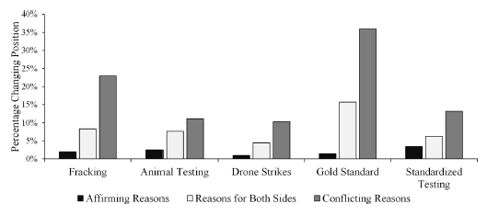
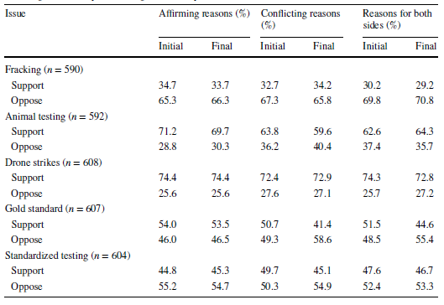
Stanley et al. (2019)
Q1: How likely are people to change their positions about socio-political issues after evaluating different sets of reasons?
Notes:
→ participants who evaluated conflicting reasons only were significantly more likely to change their initial positions than participants who evaluated affirming reasons only
→ for all sociopolitical issues except standardized testing, people who had both reasons/sides were more likely to change their mind than people with affirming reasons only
→ for all 5 issues, no matter the set of reasons, participants were more likely to stick with their initial decisions than to change them

Slide 42
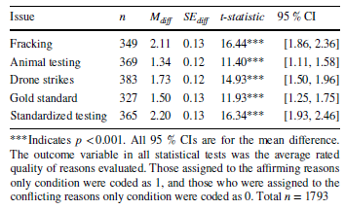
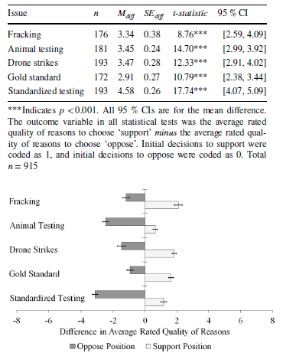
Stanley et al. (2019)
Q2: For those who don’t change their position, do they evaluate the reasons available to them in a biased way, favoring those that back their initial choice?
-> does prior knowledge or reason novelty matter?
-> what about the people who reported not making decisions based on any reasons?
Notes:
→ overall participants who did not change their minds & saw both sets of reasons rated reasons favoring their initial chosen positions as better than those reasons favoring the other, unchosen positions
→ for participants who did not change their minds relative to participants who did change their minds, participants who evaluated only conflicting reasons rated those reasons less favorably than participants who evaluated only affirming reasons
→ the effect of condition (affirming vs. opposing reasons) on reason evaluation is exclusive to participants who didn’t change their minds
→ even after controlling for prior knowledge and reason novelty, the relationships hold
→ identify subset of people who didn’t make a decision based on reasons, yet even they showed evidence for evaluating the reasons that support their positions better
“Fig. 3 Means and standard error bars represent the differences in the average rated quality of reasons between the two possible positions from which to choose (i.e., to support or to oppose) for those participants who evaluated reasons for both sides and who did not change their positions (n = 915). Difference scores were computed for each individual participant by subtracting the average rating of reasons for choosing ‘oppose’ from the average rating of reasons for choosing ‘support’”

Slide 43
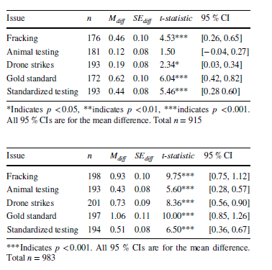
Stanley et al (2019)
Both sides
Q3: Do those who stick with their initial positions after evaluating reasons become more confident in the superiority of their positions after considering reasons?
Conflicting only
Affirming only
Notes:
→ participants were more confident in their final decisions after evaluating reasons than they were before evaluating reasons
→ even controlling for prior knowledge & number of novel reasons evaluated…
→ but not statistically significant for the people who evaluated conflicting reasons, so they’re the only ones who didn’t have this kind of polarizing effect

Slide 44
Is misinformation driven by political motivated reasoning? Pennycook & Rand (2018)
How did they test this? What did they find? What do you want to know more about, & what were limitations?
Take the next 5 min to discuss with the other folks in the class near you & refresh your memory of the article

Slide 45
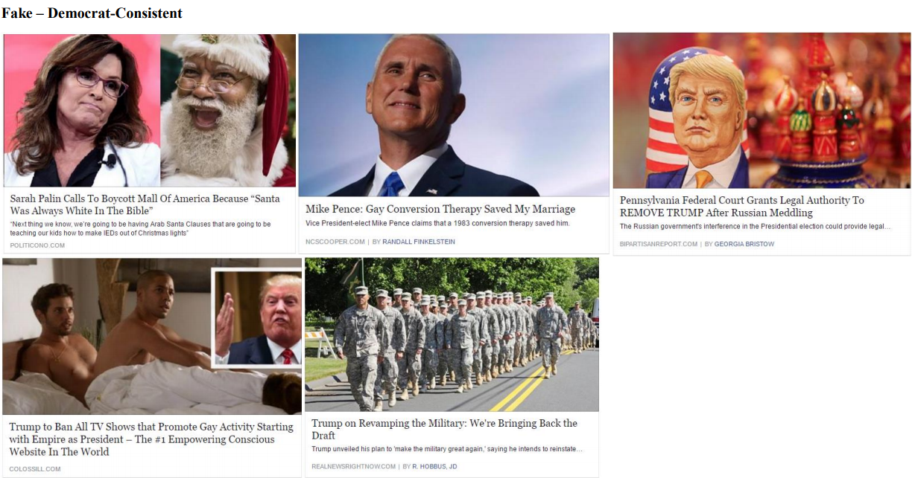
Notes:
Study 1 - from supplementary material

Slide 46
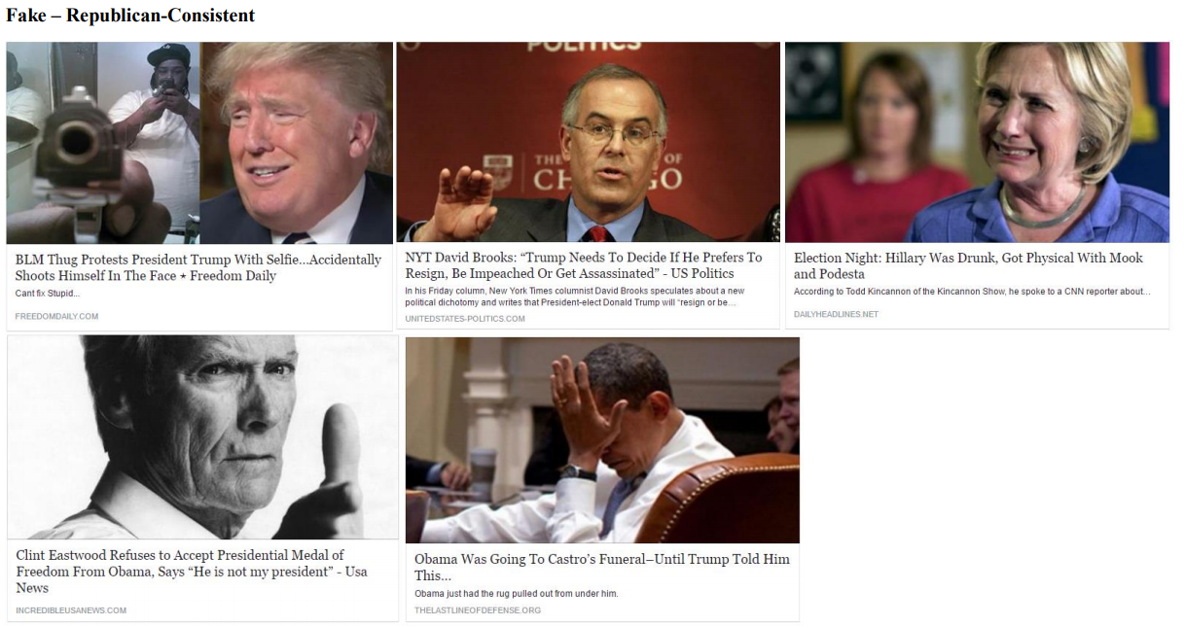
Notes:
Study 1 - from supplementary material

Slide 47
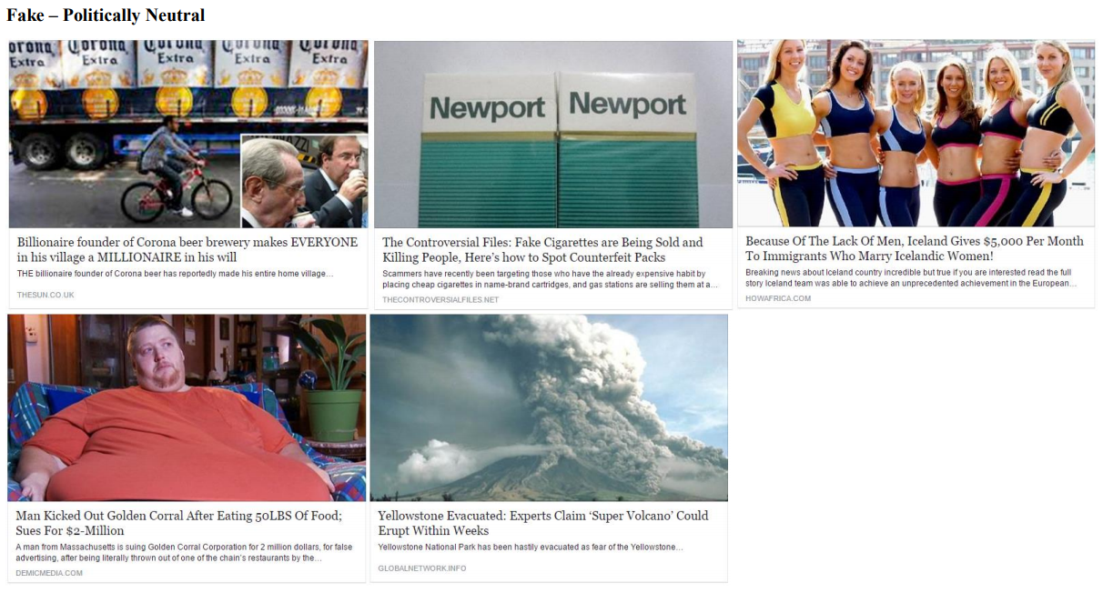
Notes:
Study 1 - from supplementary material

Slide 48
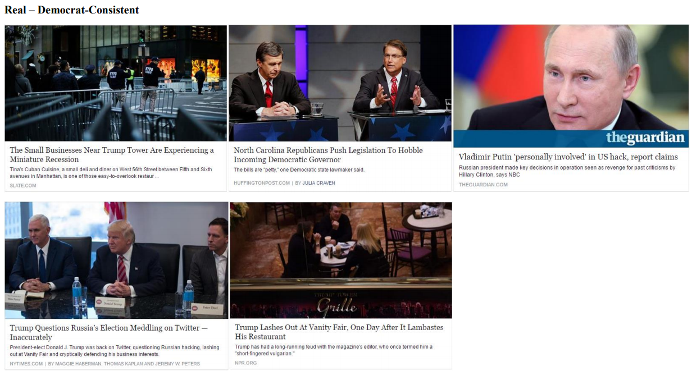
Notes:
Study 1 - from supplementary material

Slide 49
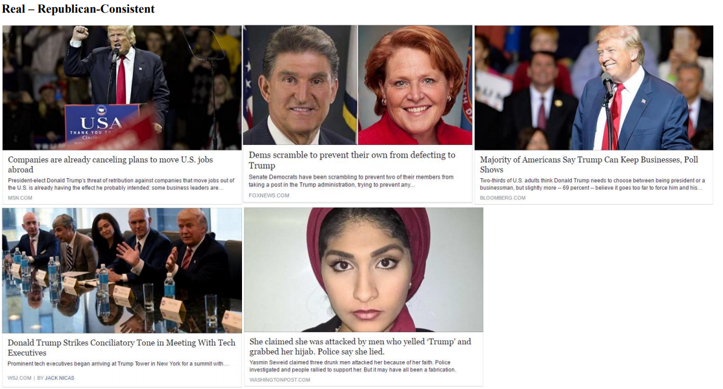
Notes:
Study 1 - from supplementary material

Slide 50
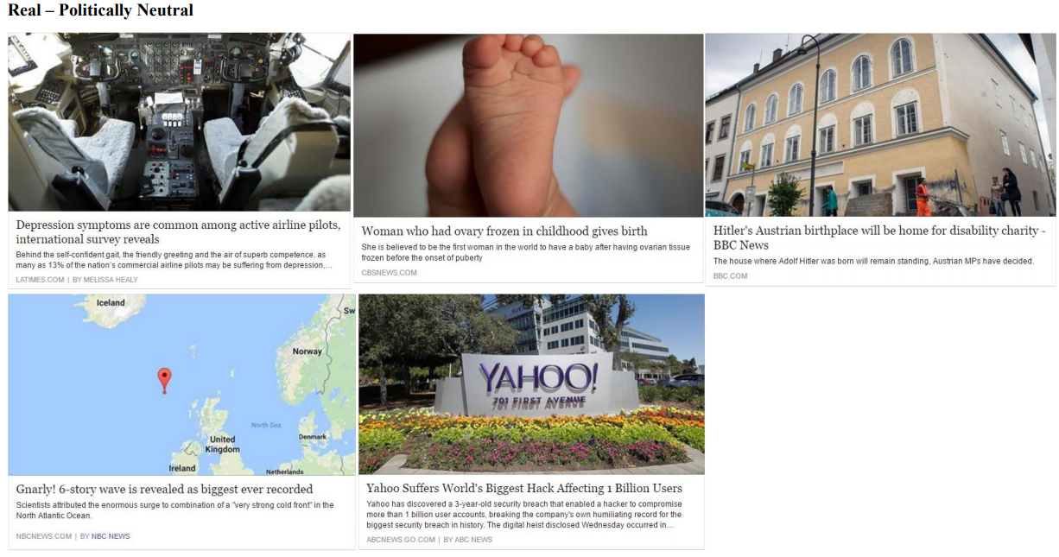
Notes:
Study 1 - from supplementary material

Slide 51
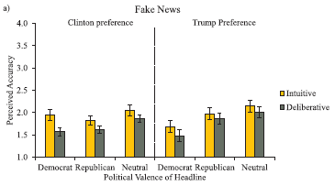
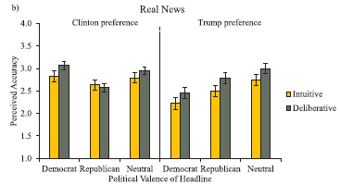
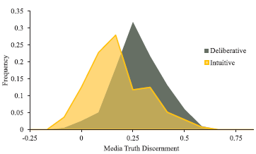
Pennycook & Rand (2018)
Notes:
→ more analytic individuals rated fake news as less accurate regardless of whether it was consistent or inconsistent with their political ideology
→ general tendency for more analytic individuals to rate real news as more accurate; more analytic individuals could better differentiate between fake and real news

Slide 52
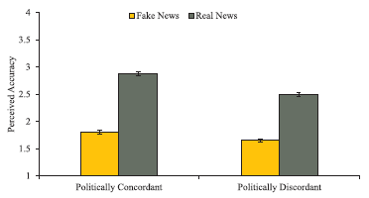
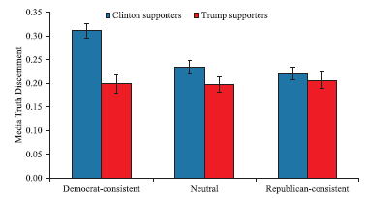
Pennycook & Rand (2018)
What differed in Studies 2 and 3?
How could you motivate people to change their beliefs? (A bit of a stretch here).
Notes:
→ difference in perceived accuracy between fake & real news was larger for politically concordant headlines than discordant headlines
→ 3-way interaction such that Clinton supporters better able to discern fake vs. real democrat-consistent stories, but not the same for Trump supporters
→ difference for politically neutral stories is significant, suggesting that their trump supporters were less likely to form accurate beliefs about news content
→ study 2: trump supporters were better at discerning Republican-consistent real from fake news than were Clinton supporters
→ study 3: use their pre-test ratings of plausibility to correlate with the CRT, across real/fake news stories for clinton & trump supporters
→ CRT correlates negatively with implausible political news headlines, but positively with perceived accuracy of relatively plausible news headlines
→ partisanship is not correlated with CRT/accuracy relationship
→ Motivating change of beliefs by teaching more critical thinking! Inductive reasoning, etc.

Slide 53
Quiz
Define, identify, and apply previous constructs that we have discussed in class

Slide 54
Today’s Goals + Agenda
LO1: Continue to build a supportive classroom culture & discuss science communication.
How does the media cover research on motivated reasoning?
What do these papers mean in terms of how we would communicate controversial science? We will reconsider this in sum on Monday.
LO2: Define, identify, and apply previous constructs that we have discussed in class
Quiz on material covered since the last quiz: multiple choice & short answer
LO3: Describe the basic fundamental principles underlying human judgment & connect to our critical analysis of journal articles.
Describe basic research on motivated reasoning, inductive reasoning, representativeness heuristic, availability heuristic, conjunction rule, confirmation bias, law of large numbers, peak-end effect & loss aversion, etc.,
How does this research impact our approach to the scientific method & open science?
What does this research suggest about how we can change people's minds?

Slide 55
Participation + Minute Paper
https://tinyurl.com/PSY102Participation
https://tinyurl.com/PSY102MinutePaperJune7

Slide 56
Additional Practice
Optional: Test Yourself

Slide 57
So… what are heuristics?
Which is closest to the truth?
Heuristics inevitably mislead you during decision-making
Heuristics are cognitive shortcuts that are both optimal in the long run and virtually always true for a given instance
Heuristics are cognitive shortcuts that are optimal in the long run but sometimes mislead you during decision-making

Slide 58
Name the Error in Judgment
Events that are more easily remembered as judged as more probable
Strong correlation between two events appears to exist, but doesn’t.
Probability that A is a member of class B is determined by how well properties of A resemble properties usually associated with B.
Relative proportions of different classes in the population.
Probability of conjunction of two events (A and B) cannot be higher than the probability of single constituents.
The larger the number of individuals drawn from a population, the more representative the group will be of the entire population.
Tendency for people to generate and evaluate evidence and test their hypotheses in a way that is biased towards their own opinions & attitudes
Selectively looking for information that conforms to a hypothesis and overlooking information that argues against it.
Notes:
Availability heuristic
Illusory correlation
Representativeness heuristic
Base rate
Conjunction rule
Law of large numbers
Myside bias (type of confirmation bias)
Confirmation bias

Slide 59
When do errors occur?
When....
Easily remembered event is less probable
There is no correlation, or it is weaker than it appears to be.
Presence of similar properties doesn’t predict membership in class B.
Base rate information is not taken into account.
Higher probability is assigned to the conjunction.
It is assumed that a small number of individuals accurately represents the entire population.
People let their own opinions and attitudes influence how they evaluate evidence needed to make decisions.
There is a narrow focus only on confirming information.
Notes:
Availability heuristic
Illusory correlation
Representativeness heuristic
Base rate
Conjunction rule
Law of large numbers
Myside bias (type of confirmation bias)
Confirmation bias

Slide 60
Consider the following argument:
Observation: Here in Nashville, the sun has risen every morning.
Conclusion: The sun is going to rise in Nashville tomorrow.
The argument is weak because there is only one specific case
The argument is strong because the premise includes scientific evidence
The argument is weak because the observation does not consider other cities.
The argument is strong because there are a large number of observations.

Slide 61
At a lunch meeting with a client, the CEO of Gossip Polls, Inc., was asked to determine America's favorite day of the week. Hundreds of Gossip employees across the U.S. started collecting data immediately, calling people at their residences. One hour later, the attitudes from 10,000 Americans, across all 50 states, were collected. A staff member called the CEO, still at her lunch meeting, to tell her the results of the poll: America's favorite day of the week is Monday. Given our inductive reasoning in science, we might suspect that the observations in this poll are not representative because
The participants were only asked one question for this poll
The participants were not sufficiently geographically diverse
The people who are home to answer the phone in the early afternoon are not an appropriate cross-section of the U.S. population
Everyone in America was not asked their opinion

Slide 62
Derrick purchased a new car, a Ford Mustang, less than a month ago. While sitting in traffic, Derrick says to his girlfriend, "Mustangs must be the best-selling car now. I can't remember seeing as many on the road as I have recently." Derrick's judgment is most likely biased by a(n)
Representativeness heuristic
Availability heuristic
Illusory correlation
Permission Schema

Slide 63
Jonas bought a new leather jacket after saving for many months for the luxury purchase. On the first day he went out wearing the new garment, he found a $50 bill on the sidewalk outside of his office. He now refers to the jacket as his “lucky jacket” and believes that it has some magical power to give him good fortune. Jonas's belief in the jacket's cosmic ability is an example of
The availability heuristic
An illusory correlation
Selective attention
The falsification principle

Slide 64
One hundred students are enrolled in State University's course on introductory physics for math and science majors. In the group, 60 students are math majors and 40 are science majors. Sarah is in the class. She got all As in her high school science courses, and she would like to be a chemist someday. She lives on campus. Her boyfriend is also in the class. There is a ____ chance that Sarah is a science major.
40%
50%
60%
100%

Slide 65
Lydia is 48 years old, single, outspoken, and very bright. She majored in philosophy as an undergraduate. As a student, she was deeply concerned with issues of discrimination and social justice, and she participated in anti-nuclear demonstrations. Which of the following alternatives is most probable?
Lydia is a U.S. Congresswoman
Lydia is a U.S. Congresswoman and active in the feminist movement
Lydia is a state governor
Lydia is a state governor and active in the feminist movement

Slide 66
There are two gumball machines outside the local grocery store, one large machine and one small machine. Both machines have only yellow and orange gumballs, and each machine contains 50 percent of each color. For each coin, the large gumball machine dispenses 15 gumballs, while the small machine dispenses 5. Tim is a young genius whose interests include probability and sound decision-making. His "probability project of the day" is to get a greater percentage of either of the colors, but not an equal amount of each color. Given this, and presuming Tim has only one coin,
He should use his coin in the large machine
He should use his coin in the small machine
It doesn’t make a difference which machine he uses
He should wait for other people to use the machines and see what they get

Slide 67
MC Answer Key
Slide 60: D
61: C
62: B
63: B
64: A
65: A
66: B

