Slide 1
PSY102: Introduction to Cognitive Psychology
Day 4 (05/20/19): Attention I

Slide 2
Today’s Goals + Agenda
LO1: Continue to build a supportive classroom culture & discuss science communication
Generate grading rubric for tweet summary assignment as a class
Gallery walk: peer feedback on the tweet summary assignment, given rubric
LO2: Apply principles of good science communication
Apply list of science communication principles we generated to handouts with good and bad headlines and lead sentences & clarify headline/lead assignment
LO3: Describe the basic fundamental principles of attention
Demos: visual search, change blindness, selective attention (STR) & brief lecture/guide
If there’s time: How do lay theories of attention (e.g., NPR podcast) fit in with these theories? Contrast with Russ Poldrack blog post.
LO4: Summarize and critically analyze academic journal articles
Discuss Kang & Wheatley (2017) & Middlebrooks et al. (2017)

Slide 3
Quick PSA
“Exploratory” research means that it was not hypothesized from the beginning and that researchers are just exploring relationships in the data.
This is not inherently bad; what’s bad is if people don’t acknowledge what is exploratory
Amazon Mechanical Turk is crowdsourced research

Slide 4
Peer Feedback on, and Rubric for Tweet Summaries
Continue to build a supportive classroom culture & discuss science communication

Slide 5
Rubric & Gallery Walk
First decide as a class on rubric for tweet summaries
Gallery Walk:
Around the room, anonymized tweet summaries are posted.
Knowing these are your classmates, and knowing the rubric we just agreed on for these tweet summaries, use your post-it notes to give your classmates feedback on their tweets
Please make these legible - I will type them up and send them to each of you

Slide 6
Good and Bad Headlines & Lead Sentences
Apply principles of good science communication

Slide 7
Attention
Describe the basic fundamental principles of attention

Slide 8
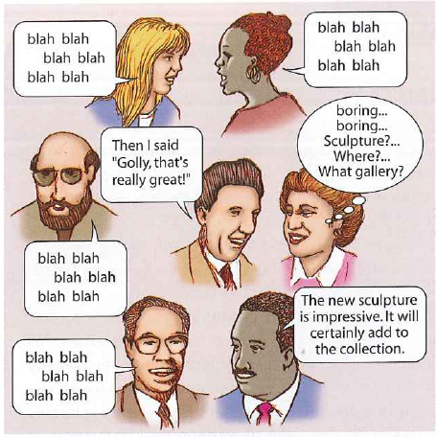
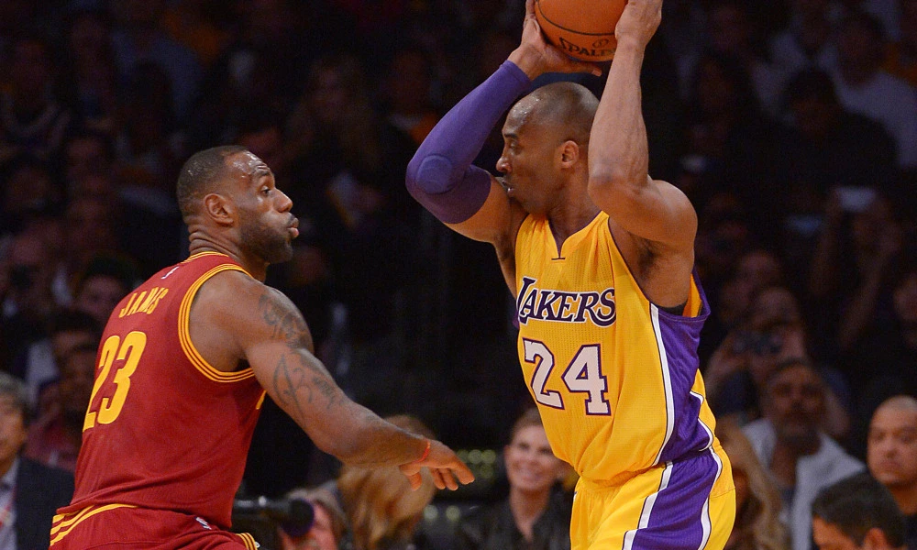
“Cocktail party effects” illustrate that:
Attention is selective
Attention is capacity-limited
E.g., attentional blink; load theories of attention
Attention can select information based on various features (voice, content)
Attention can be driven internally or ‘captured’ externally
Attention can be allocated covertly
without moving the eyes (covert)
Notes:
Cocktail party effect: the ability to focus on one stimulus while filtering out other stimuli (can focus on what people are saying at a party even when it’s really noisy).
The key characteristic of attention is its selectivity: Attended information is processed faster and more accurately than unattended information, as if attention were providing a ‘signal gain’ or amplification to the attended (selected) information. Another definition for selectivity: –Ability to focus on one dimension of a stimulus while ignoring others.
Other popular metaphors for attentional selectivity have cast attention as a ‘spotlight’ or ‘filter’, or as biasing the competition for processing resources between different stimuli.
Attention is also ‘capacity-limited’, in that we can only attend effectively to a limited amount of information. (Note though that selectivity and capacity limitations are really two sides of the same coin!)
Image credit: https://ftw.usatoday.com/2016/03/kobe-bryant-pump-faked-lebron-james-lakers-cavs & Huettel et al. cog neuro textbook
Overt attention: shifting attention from one place to another by moving the eyes
Covert attention: shifting attention from one place to another while keeping the eyes stationary (e.g., basketball players stealthy moves)
Central vision: the area you are looking at; peripheral vision: everything off to the side
Pausing on one particular face or object – fixation
Moving your eye to observe another face -> saccade eye movement

Slide 9
Selective Attention: Task is to say aloud the printed ink color, ignoring the meaning of the word

Slide 10
RED

Slide 11
RED

Slide 12
GREEN

Slide 13
YELLOW

Slide 14
The Stroop Effect
Mental representations
Task-relevant vs. task-irrelevant
Automaticity
Perceptual Load
Notes:
Perceptual load – the difficulty of a task
· Low-load tasks take up a small amount of a person’s processing capacity
· High-load tasks take up more of the processing capacity
Load Theory of Attention:
· If there is processing capacity left, can still process task-irrelevant stimulus, slowing down responding (b/c not supposed to respond to task-irrelevant)
· If no capacity left, less likely to be distracted by other stimuli
o Ability to ignore task-irrelevant stimuli also a function of how powerful the task-irrelevant stimulus is + load of the task

Slide 15
Identifying Spies with Psychology
Notes:
https://twitter.com/qikipedia/status/1124629995811250176

Slide 16
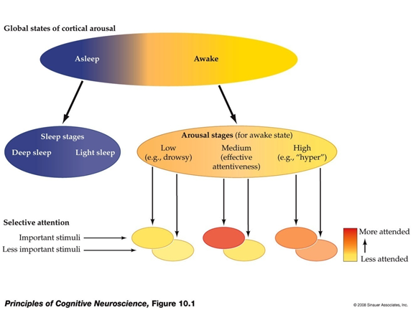
Attention vs. Arousal
Attention is selective
Arousal is global
Attentiveness varies with arousal in an ‘inverted U- shape’
Notes:
Important for Thalia Wheatley paper

Slide 17
What order do these go in?
Make meaning out of the stimuli (i.e., process it)
Sense the physical features of a stimulus (pitch, volume; color, motion; etc.)
Select what you want to pay attention to
Are you picking features? Are you picking stimuli?

Slide 18
Early Selection: Broadbent’s Filter Model of Attention (1958):
If you don’t attend to it, it’s lost
Notes:
o If you don’t attend to it, it’s lost
§ Sensory memory: all incoming info for short time, transfers to filter
§ Filter identifies the message being attended to based on physical characteristics and lets only the attended message through
§ Detector processes information from attended message to determine higher level characteristics of the message; processes all info that comes thru (the info that comes thru is highly selective – it’s been filtered)
§ Output sent to short-term memory
o A Bottleneck Model – filter restrict information flow
o Early selection model – filter eliminates unattended info @ beginning of info flow

Slide 19
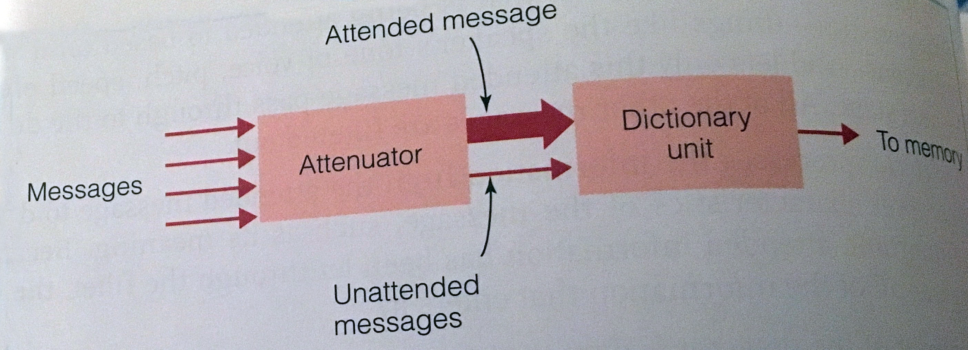
Early Selection: Treisman’s attenuation model of attention (1964):
Your Name: low threshold; “Whitehead”: probably high threshold
Notes:
Image credit: Cengage
· Treisman’s model of attention:
o Replaced Broadbent’s filter with attenuator, which analyzes message for physical characteristics, language, and meaning. Information is still selected, but language and meaning can also now influence what is selected. Once messages identified, attended message is passed through attenuator, unattended is attenuated (not as strong) as attended message
o A “leaky filter” model
o “Dictionary unit” – words, stored in memory, which have a threshold for being activated (i.e., smallest signal strength that can be detected)

Slide 20
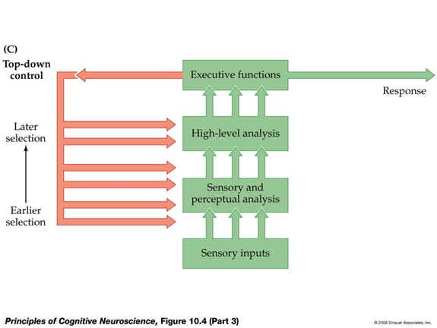
Late Selection Models
People used dichotic listening tasks to differentiate the models, but no one answer to early vs. late debate
Notes:
· Dichotic listening task w/ ambiguous words, which influenced behavioral reports. Because the meaning of words can influence subjects’ judgments, words must be processed to the level of meaning even if unattended.
· Late selection models of attention: most of the incoming information is processed to the level of meaning before the message to be further processed is selected
No one answer to the early-late controversy; early selection demonstrated in some circumstances, late in others. Focus shifted to the factors that control attention.
Image credit: https://www.simplypsychology.org/attention-models.html

Slide 21
Top-down vs. Bottom-up
Bottom-up: usually refers to start of stimulus processing (salient features of an environment)
Top-down: processing originating in the brain, possibly other signals modulating bottom-up
Stroop effect is traditionally explained as conflict between top-down vs. bottom-up

Slide 22
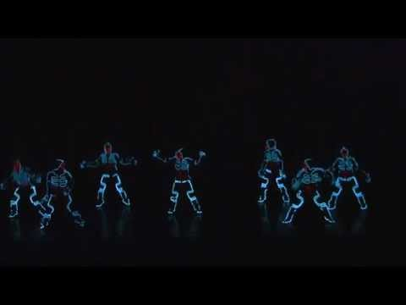
Attentional Capture
Notes:
https://www.youtube.com/watch?v=eG-VHe0Q4D8
When attention due to stimulus salience causes an involuntary shift of attention, this shift is called attentional capture
Determining how saliency influences the way we scan a scene typically involves analyzing characteristics such as color, orientation, and intensity at each location in the scene and then combining these values to create a saliency map

Slide 23
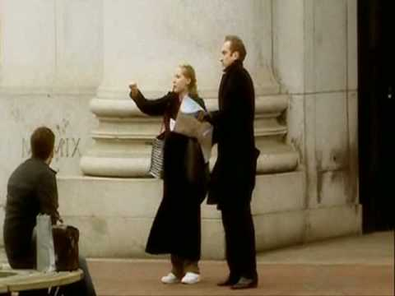
Do you notice anything?
Notes:
https://www.youtube.com/watch?v=vBPG_OBgTWg
Inattentional blindness – not attending to something that is clearly visible
I.e., what happens when you don’t pay attention

Slide 24
Change Blindness
Notes:
https://www.youtube.com/watch?v=bh_9XFzbWV8
Perceptual system focuses on only a small portion of the environment is one of its most adaptive features – focusing on what’s important, perceptual system is making optimal use of our limited processing resources

Slide 25
Binding: Treisman’s Feature Integration Theory (1980)
Notes:
Binding – the process by which features such as color, form, motion, and location are combined to create our perception of a coherent object
Binding Problem – how do individual features of an object become bound together?
Anne Treisman’s feature integration theory – a 2-stage process
-Preattentive stage: objects are analyzed into separate features
Illusory conjunctions: combinations of features from different stimuli
-Focused attention stage: free-floating features are combined in the second stage
Balint’s syndrome – inability to focus attention on individual objects (case of R.M.)

Slide 26
Visual Search Task
When you see these vertical lines, say “yes” as fast as you can. If there are none, say “no” as fast as you can.

Slide 31
Instead of vertical lines, look for red lines

Slide 34
Conjunction Search
If there are red vertical lines say “yes” as fast as you can. If there are no red vertical lines say “no” as fast as you can. There must be lines that are red AND vertical for a “yes.”

Slide 37
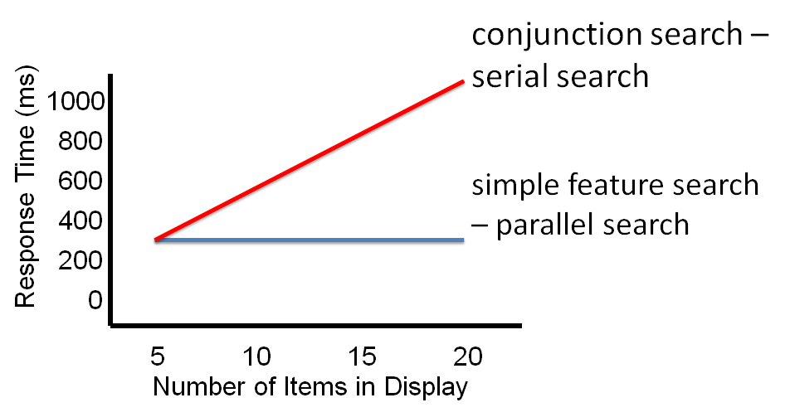
Typical Results

Slide 38
Applications of Visual Search
https://vimeo.com/324295540
https://vimeo.com/329433357
E.g., radiology scanning for cancer, TSA airport officers scanning bags

Slide 39
Takeaways
In an early selection model, attention has to happen before [most of the] higher-level processing. In a late selection model, [at least some] processing occurs before attention.
There’s some evidence for both early selection and late selection; it depends on the context (e.g., different dichotic listening tasks).
Sometimes voluntary effort is involved in attending (or ignoring), and sometimes it isn’t. We also don’t pay attention to everything.
Attention is selective, capacity-limited, internal/external, covert/overt, related to arousal.

Slide 40
Kang & Wheatley (2017) + Middlebrooks et al. (2017)
Summarize and critically analyze academic journal articles

Slide 41
Today’s Goals + Agenda
LO1: Continue to build a supportive classroom culture & discuss science communication
Generate grading rubric for tweet summary assignment as a class
Gallery walk: peer feedback on the tweet summary assignment, given rubric
LO2: Apply principles of good science communication
Apply list of science communication principles we generated to handouts with good and bad headlines and lead sentences & clarify headline/lead assignment
LO3: Describe the basic fundamental principles of attention
Demos: visual search, change blindness, selective attention (STR) & brief lecture/guide
If there’s time: How do lay theories of attention (e.g., NPR podcast) fit in with these theories? Contrast with Russ Poldrack blog post.
LO4: Summarize and critically analyze academic journal articles
Discuss Kang & Wheatley (2017) & Middlebrooks et al. (2017)

Slide 42
Tomorrow’s Work
Reading worksheets for:
Weschler et al. (2018)
Seli et al. (2018) (Duke article, like Gruters)
Plus write 3 versions of a headline/lead sentence for either Weschler, Kang, or Middlebrooks article - choose one of the two you didn’t already write about for the tweet summaries
Saving Duke articles for the blog post
15 minute Quiz on material so far
NPR’s Life, Interrupted
0-5:02; 29:28-rest. If you want to listen to more, you’re welcome to.
Notes:
-Attention residue
-zapping the brain & multitasking

Slide 43
Participation + Minute Paper
https://tinyurl.com/PSY102Participation
https://tinyurl.com/PSY102MinutePaperMay20

